Slide 1



Reading, Writing, and the Scientific Literature

Slide 2
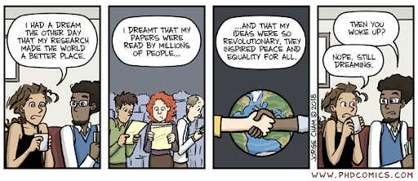
Daily Agenda
Categorizing, evaluating, finding, and organizing sources (20 min)
Critically reading papers (20 min)
Writing scientifically (20 min)
Structuring a white paper (20 min)

Slide 3
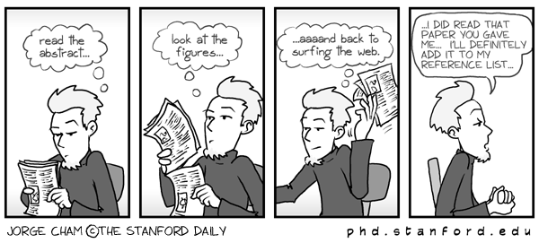
I. Scientific Sources

Slide 4
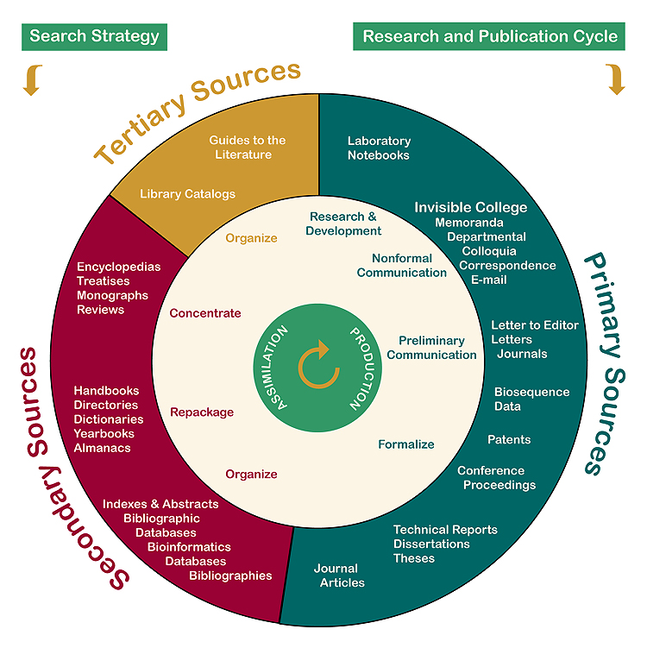
Types of sources
Notes:
Primary sources: documents of direct experience; formal or informal; formal examples usually peer reviewed.
Secondary sources: organize, distil, or review primary sources. Review articles are a type of secondary source that can be very useful for understanding and finding primary sources.
Tertiary sources: discovery tools for primary and secondary sources.

Slide 5
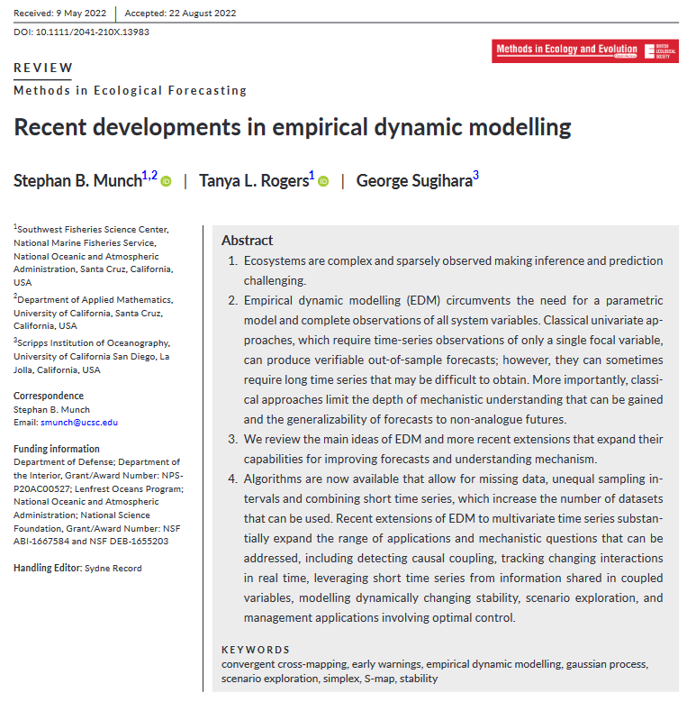
Is this a primary, secondary, or tertiary source?

Slide 6

Is this a primary, secondary, or tertiary source?

Slide 7
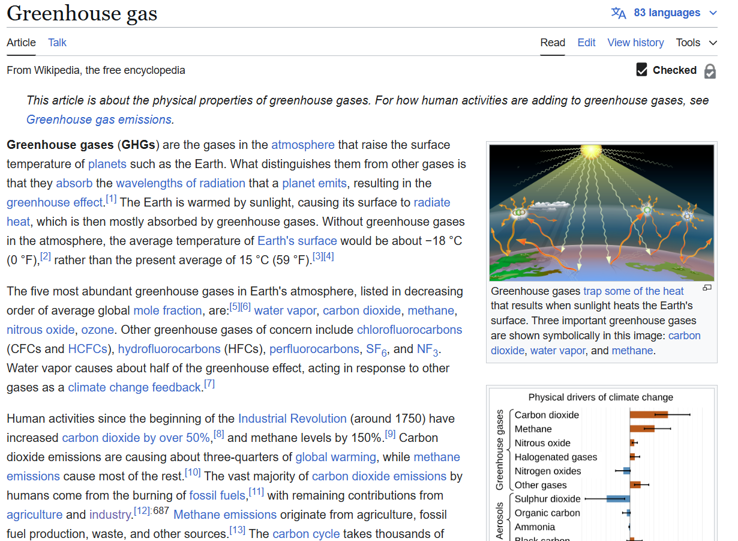
Is this a primary, secondary, or tertiary source?

Slide 8
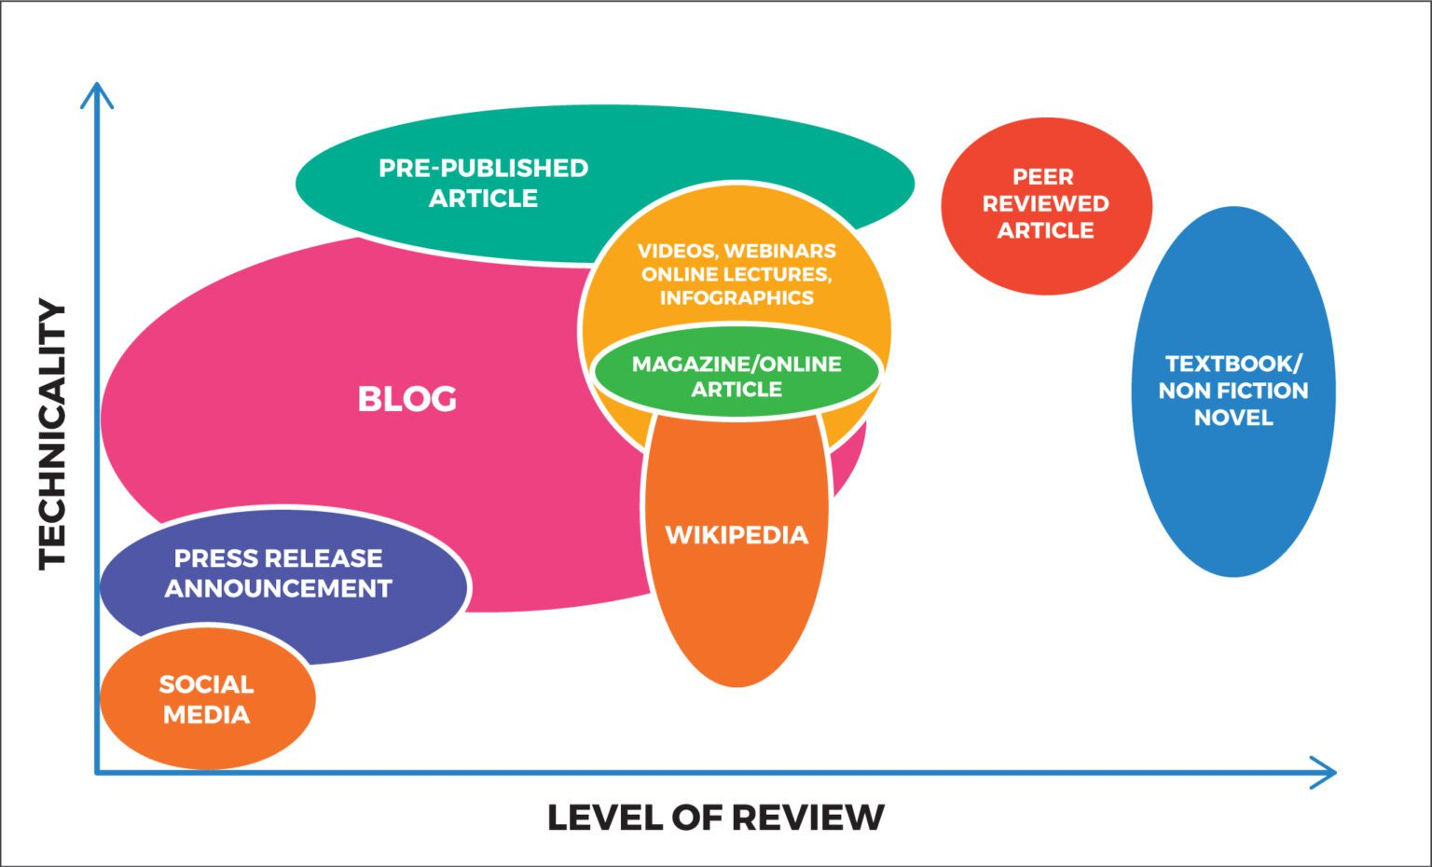
CLASS WHITE PAPERS

Slide 9
What is citable for this class?
 | Primary | Secondary | Tertiary
Peer-reviewed | YES | YES | NO
Non-reviewed | DEPENDS | DEPENDS | NO
Non-reviewed examples | Ok to cite?
Preprints | YES
Blog/Substack posts | NO
Dissertations/theses | YES
Social media posts | NO
Government documents | YES
Newspaper articles | YES

Slide 10
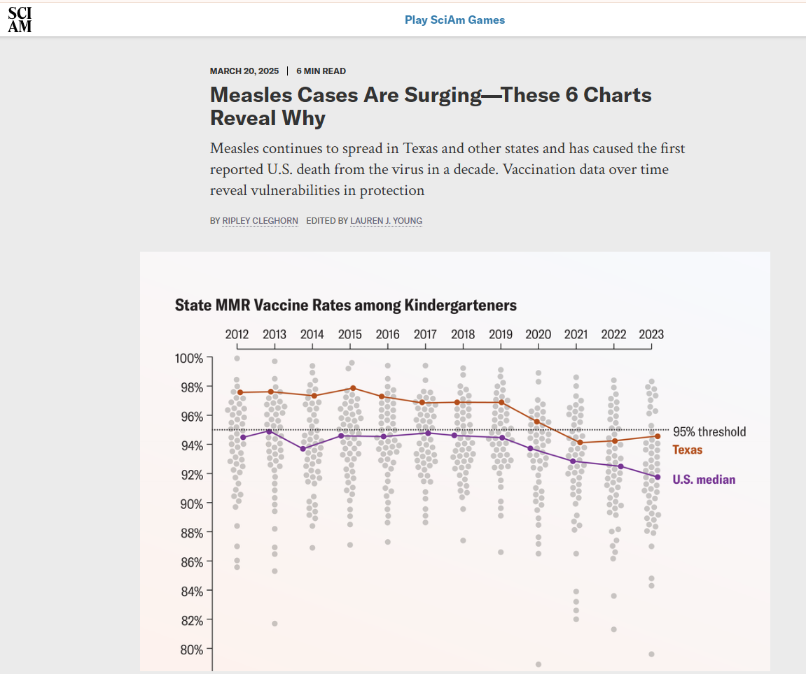
Is this source citable?

Slide 11
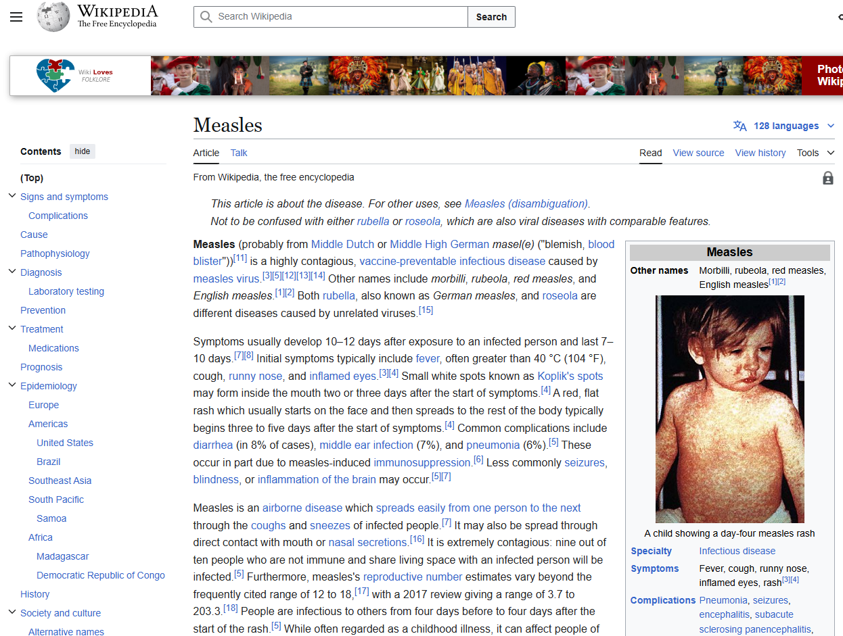
Is this source citable?

Slide 12
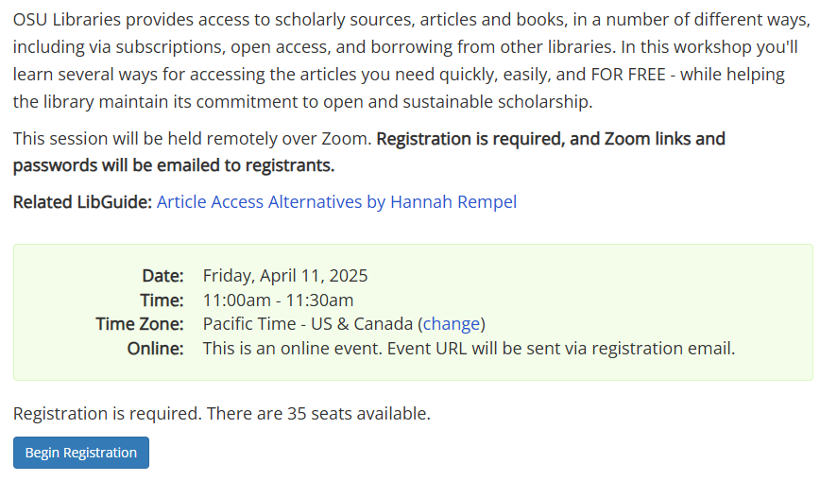
Finding Articles: OSU Library Workshop
GEOG 463 extra credit:
1% added to your final grade for attending this workshop!!

Slide 13

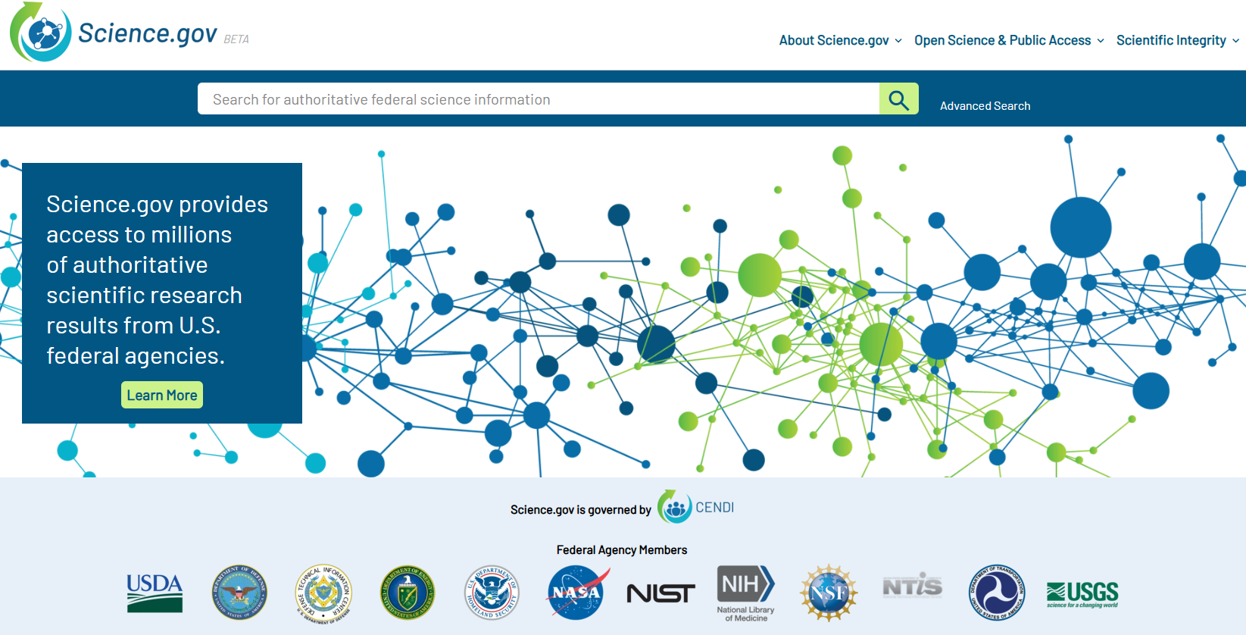
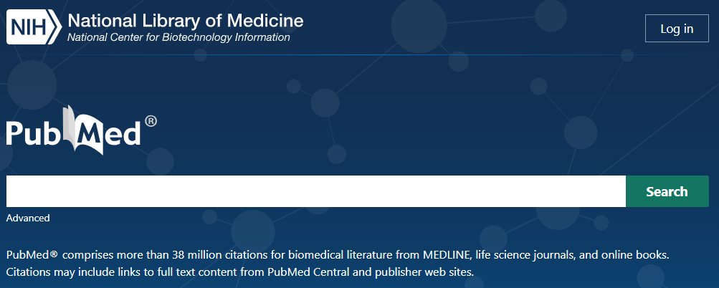

Scholarly search engines

Slide 14
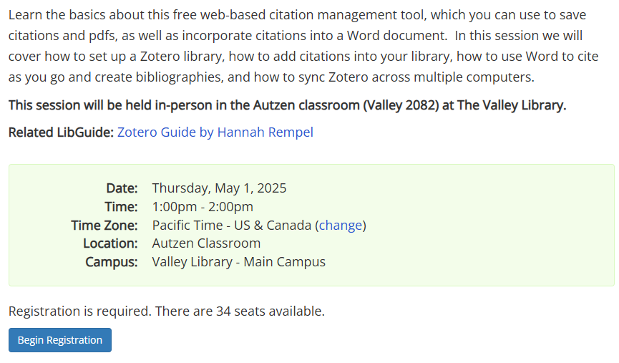
Organizing Articles: OSU Library Workshop
GEOG 463 extra credit:
1% added to your final grade for attending this workshop!!

Slide 15
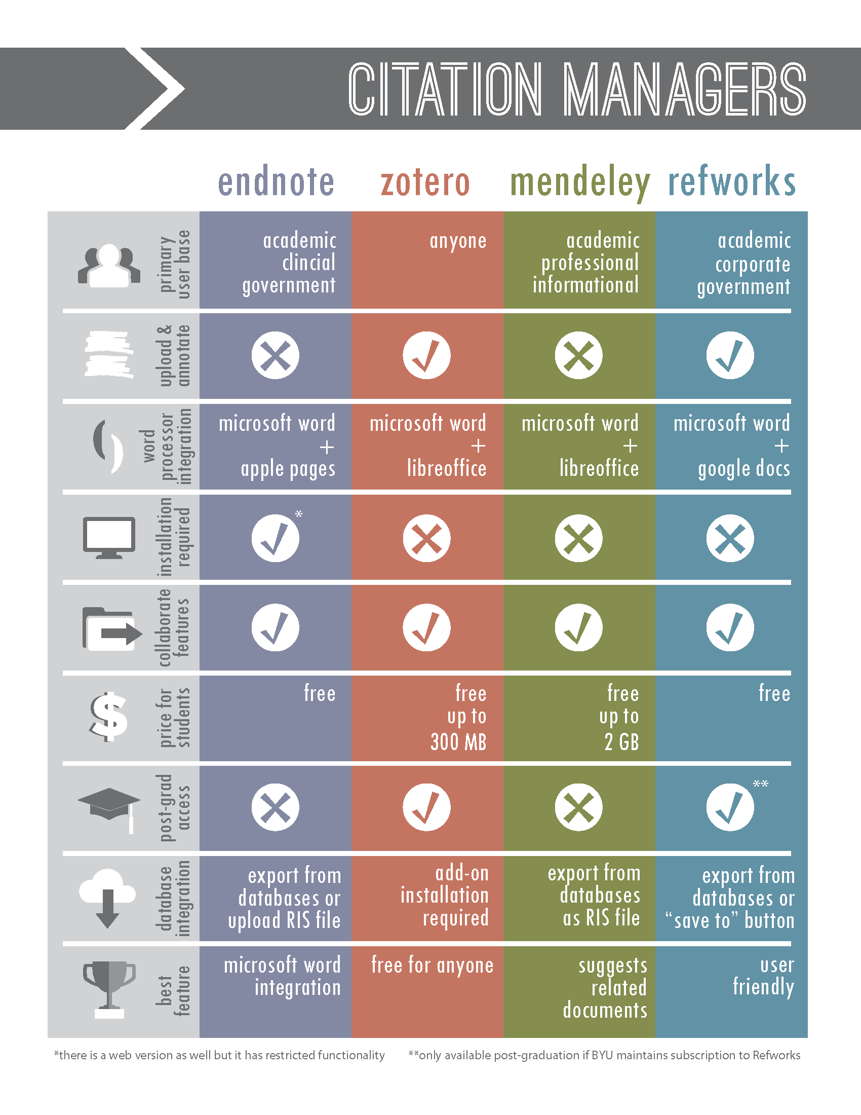

Citation management

Slide 16
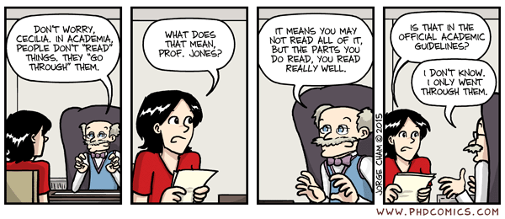
II. Reading Papers Critically
Notes:
https://lib.purdue.edu/wp-content/uploads/2024/06/Newest-Scientific-Paper.pdf

Slide 17
Why is it important to read the literature?
Papers provide a current understanding of the field
Articles include enough information for you to repeat the study
The results, figures, and tables present actual data
Papers show the reasoning behind conclusions, which you can judge for yourself

Slide 18
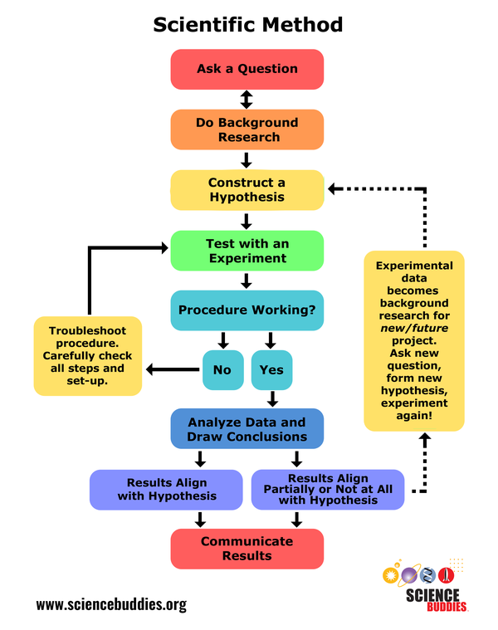
Typical paper sections
Abstract
Introduction
Materials and methods
Results
Discussion
Acknowledgements
References
What steps of the scientific method belong in each paper section?

Slide 19
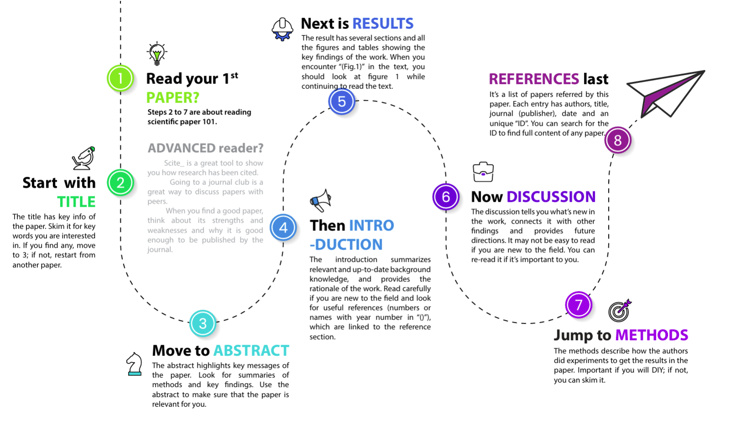

Slide 20
Questions to ask yourself while reading
Is the organization of the article satisfactory?
Does the introduction set the manuscript in an appropriate context and show how it builds on previous work on the subject?
Are the methods correctly described and sufficiently informative to allow replication of the research?
Are the data analyzed using the appropriate statistical methods?
Are the authors’ claims supported by the evidence provided?
Are the interpretations and conclusions sound, justified by the data and consistent with the paper’s objectives?

Slide 21
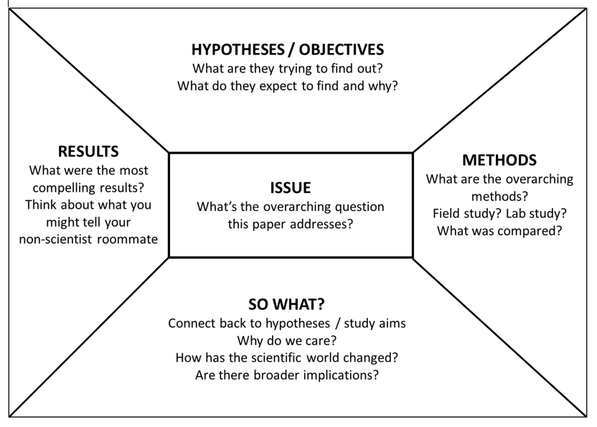

Slide 22
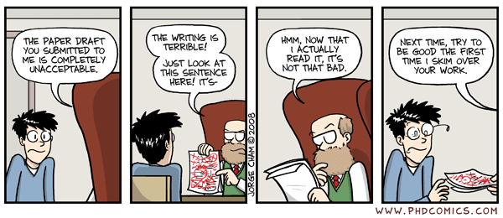
III. Scientific Writing

Slide 23
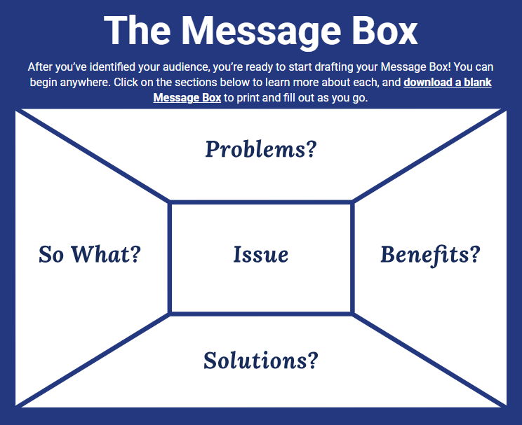

Slide 24
Scientific writing process
What we think the writing process should be: linear.
Prewriting
Drafting
Revising
Editing
Publication
What the writing process actually is: iterative.
Revisions from coauthors and colleagues
Prewriting
Drafting
Revising
Editing
Publication
Revisions from peer reviewers and editors
Notes:
Prewriting – generate ideas, identify evidence and sources, and craft outlines
Drafting – transform the outline into logically connected sentences and paragraphs, add evidence
Revising – reorganize the draft, add evidence, eliminate tangents, correct misspellings and grammar, check citations and figures
Editing – submit for peer review
Publication – revise for copyediting after acceptance

Slide 25


Sentence styles
Past tense, active voice, personal
“We conducted an experiment to measure the effects of ultraviolet radiation on the productivity of marine phytoplankton.”
Present tense, active voice, personal
“We conduct an experiment to measure the effects of ultraviolet radiation on the productivity of marine phytoplankton.”
Past tense, passive voice, personal
“An experiment was conducted by us to measure the effects of ultraviolet radiation on the productivity of marine phytoplankton.”
Past tense, passive voice, impersonal
“An experiment was conducted to measure the effects of ultraviolet radiation on the productivity of marine phytoplankton.”

Slide 26
Latin phrases
et al. = et alia = and others
Used to replace multiple names, especially in bibliographic information
i.e. = id est = that is/in essence/in other words
Used to provide a further definition or clarification
e.g. = exempli gratia = for example
Used to provide supporting examples that are not exhaustive
sensu = in the sense of
Used to denote intended meaning or refer to an authority
a priori = from what is earlier
Used to describe knowledge that comes from the power of reasoning based on self-evident truths
a posteriori = from what is later
Used to describe knowledge based solely on personal experience, experimentation, or observation

Slide 27
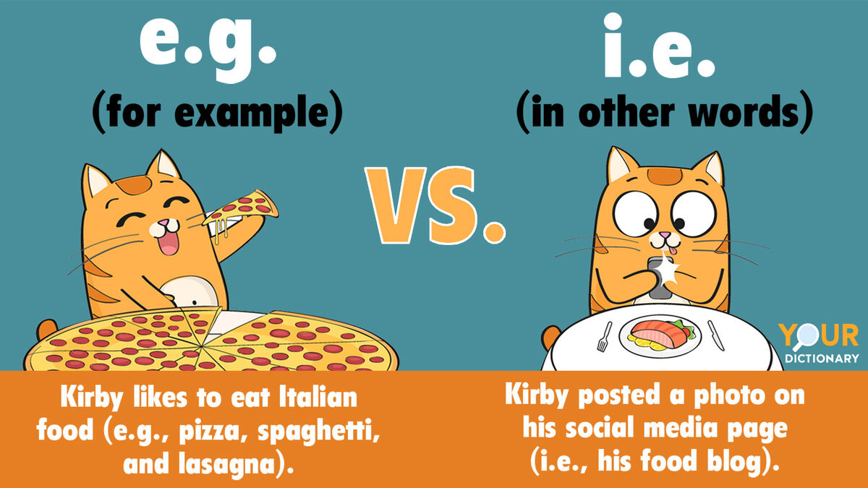

Slide 28
Recommended writing order
Methods – easiest to write, some citations
Grandma Meunier: “The hardest part of any job is getting started!”
Results – next easiest to write, minimal citations
Dedicate about 1 paragraph to each figure and table
Discussion – second hardest to write, considerable citations
Start narrow and end broad
Introduction – hardest to write, maximum citations
Start broad and end narrow
Abstract – summarize everything, no citations

Slide 29
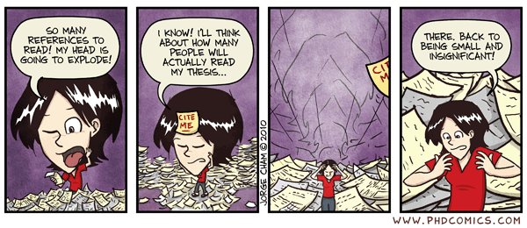
IV. White Papers
Notes:
https://writingcenter.gmu.edu/writing-resources/different-genres/white-papers

Slide 30
What is a white paper?
Purpose
Document that describes a problem, proposes solutions, and makes recommendations for a specific audience
Informative
Authoritative
Persuasive
Audience
In our case, these will be real stakeholders of your choosing
Resource users
Legislators
Agency employees
Non-governmental organizations
Environmental scientists

Slide 31
What is a white paper?
Tone and Style
Although you’re advocating for a specific position, you should write objectively
No opinions or perspectives
Present facts substantiated by evidence, figures, tables, and citations
Format
Eight component sections
12-15 pages in length
Single-spaced
Not including references

Slide 32
Cover Page

Slide 33
Executive Summary
Write this section last!

Slide 34
Background

Slide 35
Problem Description

Slide 36
Solution Description

Slide 37
Recommendations

Slide 38
Conclusions

Slide 39
References

Slide 40
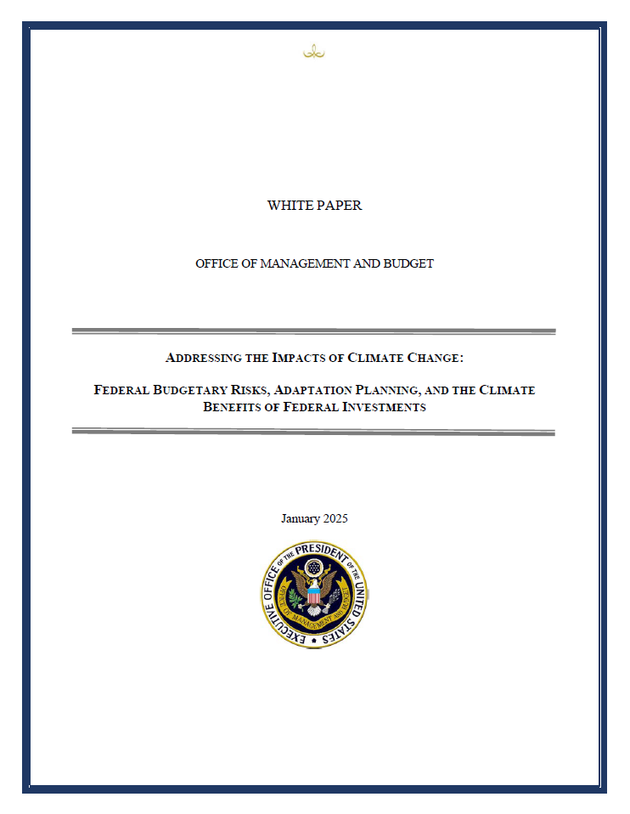

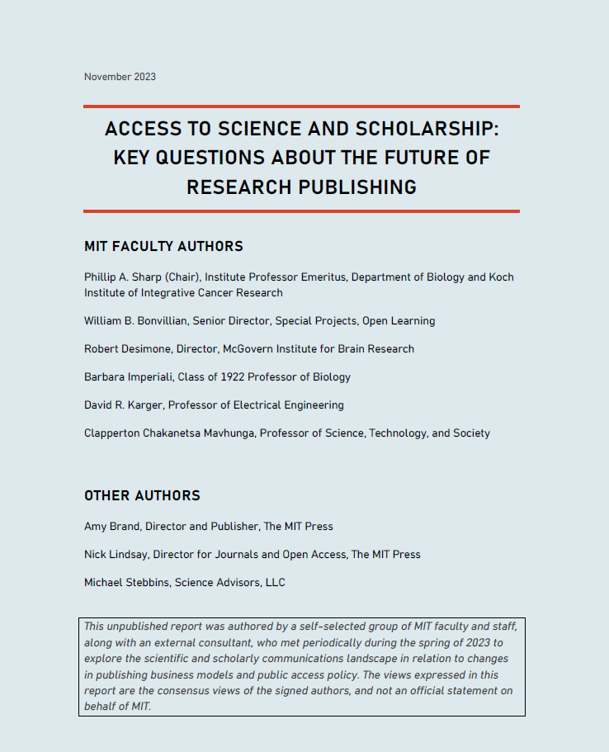
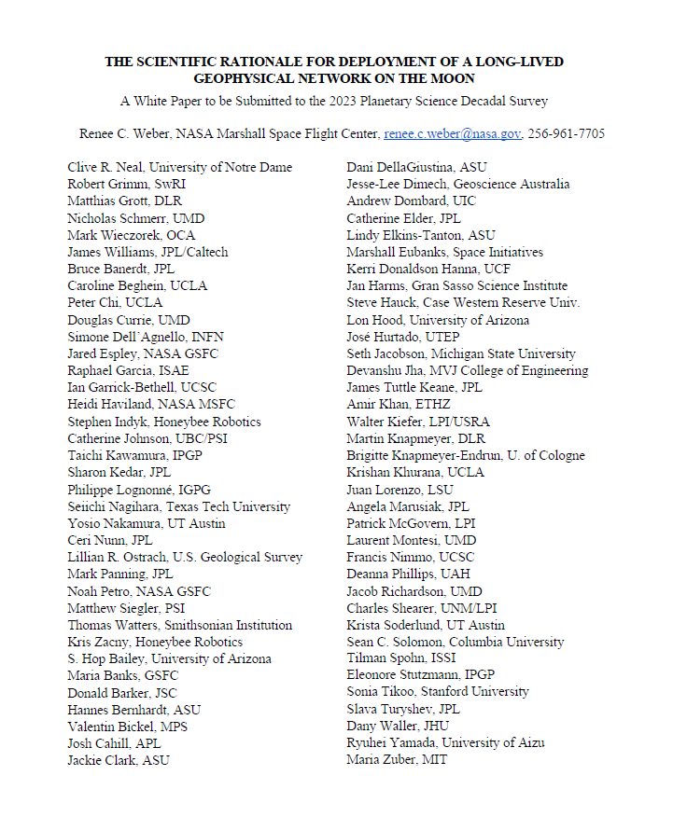
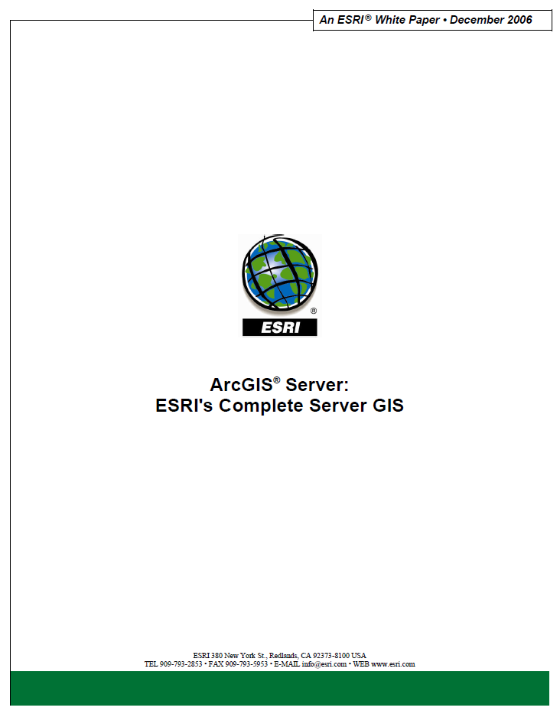
5 examples on GitHub
2 governmental examples
2 academic examples
1 industry example

